Slide 1
Create and Maintain Business Master Data Workshop A-1 Jose Diaz and Mohanta Das 5/19/26

Slide 2





Overarching Design Principles
Fit to Standard
SAP First
We will change and adapt our existing business processes to fit to standard ‘out of the box’ functionality.
We will adopt an “SAP first” strategy with all financial and operational data housed within SAP.
Minimize customizations
‘Best of Breed’ by exception
Non-SAP applications will only be considered if they are considered ‘best of breed’ and are necessary to enable competitive advantage or meet complex regulatory requirements.
We will minimize customizations and keep the core clean to ease future upgrades, improving agility and scalability.
Rationalize Applications
We will standardize and rationalize our applications to control costs and reduce the complexity of our IT estate.

Slide 3
Workshop Agenda*
TOPIC
01
Scope, Purpose, Objective
(L3) Create Business Master Data
BREAK – 10 Mins
(L3) Maintain Business Master Data
Current and Future State Assumptions
Key Decisions
FRICE-W
Drafted User Stories
3rd Party Integration
Data Migration
Key Decisions, Action Items, Change Impacts, Wrap-Up, and Next Steps
02
03
04
05
06
07
08
09
10

Slide 4
01 Scope, Purpose, Objective

Slide 5
Scope, Purpose, Objectives
Scope
Purpose
Objective
Scope of this document covers the to-be state business master data processes between SAP Service Cloud v2 and SAP S4HANAer
Describe how to create and maintain business master data
Offer a holistic view of all the key elements of the to-be process including organization/roles, configuration or customization if needed, data, reporting, security, and controls requirements.
Define the target-state ownership and L3 processes.
Document key assumptions/decisions and outline any FRICE-W's and reports.

Slide 6
Ownership
Object | Teams Impacted | Business Process Owner | Reviewer
Business Partner | Customer, Finance | Dawn Pettengill, Tarah Wilson | Shibu Prabha
Contract Account | Customer, Finance, Supply Chain | Dawn Pettengill, Tarah Wilson | Shibu Prabha
Contract | Customer, Finance, Supply Chain | Dawn Pettengill, Tarah Wilson | Shibu Prabha

Slide 7
02 (L3) Create Business Master Data

Slide 8
Business Partner Number Ranges and Replication
When creating a new business partner from SAP S4HANA, SAP will use the internal number range configured in SAP S4HANA. Once the business partner is saved, the business partner 1006483279 as an example. Replication from SAP S4HANA to SAP Service Cloud v2 will be triggered. The external number in SAP Service Cloud v2 will be used to create the same business partner number created in S4HANA. Therefore, business partner 1006483279 now exists in both systems.
When creating a new business partner from SAP Service Cloud v2, SAP will use the internal number range configured in Service Cloud v2. Once the business partner is saved, the business partner 1031941770 as an example. Replication from SAP Service Cloud v2 to SAP S4HANA will be triggered. The external number in SAP S4HANA will be used to create the same business partner number created in S4HANA. Therefore, business partner 1031941770 now exists in both systems.
No | From No | To No | Ext | Grouping | Short Name | Description | Number Range
01 | 1000000000 | 1029999999 |  | 0001 | ECC BP's | BP's Created in ECC | 01
02 | 1030000000 | 1999999999 | X | 0003 | CRM BP's | BP's Created in CRM | 02
*Note* employees will be created in S4HANA with an internal number range starting with 5* and replicate to Service Cloud v2 with an external number range starting with 8*. This is the same process that occurs today.

Slide 9
BP Roles
Custom BP Role in ECC | Description
Z3PRTY | Authorized 3rd Party
ZCORPD | Corporate Division
ZE_CAM | Employee-CAM
ZES001 | ES Services Customer
ZFAE30 | Occupant 3- Contractor
ZFAI10 | Occupant 1 - Employee
ZFAI20 | Occupant 2 – Cost Center
ZFAI40 | Field Leader
ZIDE | IDE Contract Partner
ZPARNT | Parent
ZSC001 | SC Business Partner
ZSUBSD | Subsidiary
ZSVCPR | Service Provider
ZTA001 | TA Business Partner-Vend
ZTA002 | TA Business Partner-CMS
ZTA003 | TA-SG-E2E-BusinessPartner
When a Business Partner is created n SAP, the business partner will assume one or more roles to show the nature of the business that is occurring between the business parter and Consumers.
If the business partner is the utility customer of Consumers, the business partner will have the "Contract Partner" (MKK) role. Once the business partner is created, the role can be modified, or additional roles can be assigned.
Consumers has 53 Business Partner Roles in CRM7 and 119 Business Partner Roles in ECC. Service Cloud will map the 53 roles to the corresponding S4HANA roles. The following are the custom z roles that will remain in the future state.
Custom BP Roles in CRM | Description
Z3PRTY | Authorized 3rd Party
ZCORPD | Corporate Division
ZE_CAM | Employee-CAM
ZIDE | IDE Contract Partner
ZPARNT | Parent
ZSUBSD | Subsidiary
ZSVCPR | Service Provider

Slide 10
Custom Business Partner Role Mapping
Custom BP Roles in CRM | Description | Direction of Replication | Custom BP Role in ECC | Description
Z3PRTY | Authorized 3rd Party |  | Z3PRTY | Authorized 3rd Party
ZCORPD | Corporate Division |  | ZCORPD | Corporate Division
ZE_CAM | Employee-CAM |  | ZE_CAM | Employee-CAM
ZIDE | IDE Contract Partner |  | ZIDE | IDE Contract Partner
ZPARNT | Parent |  | ZPARNT | Parent
ZSUBSD | Subsidiary |  | ZSUBSD | Subsidiary
ZSVCPR | Service Provider |  | ZSVCPR | Service Provider
CRM000 | Sold-To Party |  | MKK | Contract Partner
BUP001 | Contact Person |  | BUP001 | Contact Person
BUP003 | Employee |  | BUP003 | Employee

Slide 11
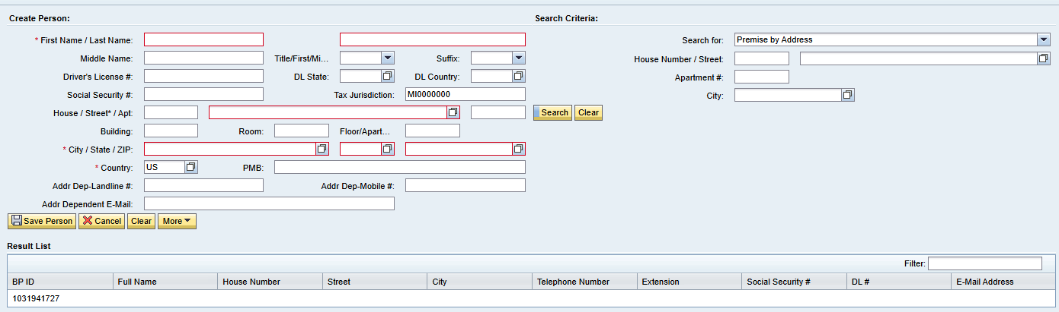
Create Person BP in CRM
A person BP has several data elements (i.e., fields) which a user will enter to better understand the attributes of the person.
Some key fields include:
First Name
Last Name
Title
Suffix
ID Types
Social Security
Driver's License
Field | Mandatory | Optional | Defaulted | Field | Mandatory | Optional | Defaulted
First Name | X |  |  | Apartment |  | X
Last Name | X |  |  | Building |  | X
Middle Name |  | X |  | Room |  | X
Title |  | X |  | Floor |  | X
Suffix |  | X |  | City | X
Drivers License # |  | X |  | State | X
Drivers License State |  | X |  | Zip Code | X
Drivers License Country |  | X |  | Country | X |  | X
Social Security # |  | X |  | PMB |  | X
Tax Jurisdiction | X |  | X | Address Dependent Landline # |  | X
House |  | X |  | Address Dependent Mobile # |  | X
Street | X |  |  | Address Dependent Email |  | X

Slide 12
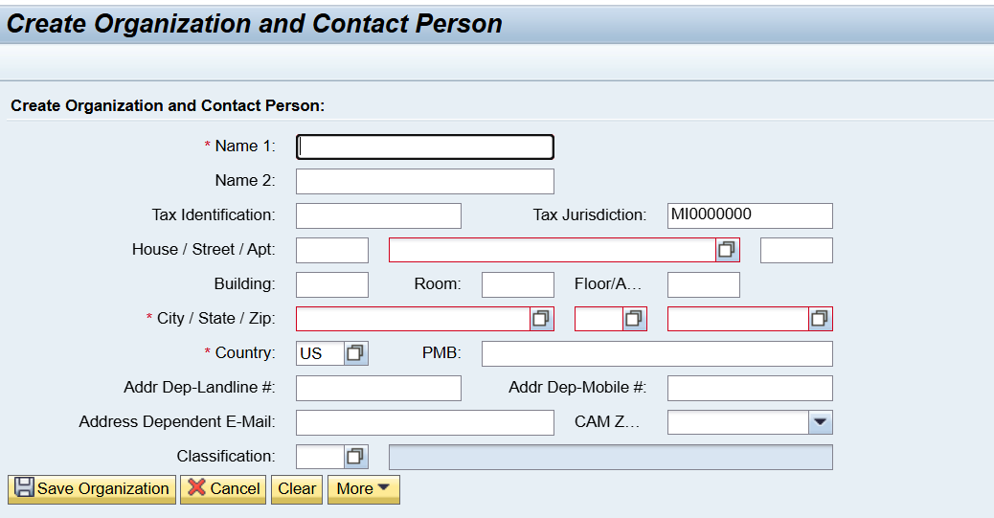
Create Organization BP in CRM
An Organization BP has several data elements (i.e., fields) which a user will enter to better understand the attributes of the person.
Some key fields include:
Organization Name
CAM Zone
Classification
ID Types
Tax ID
Field | Mandatory | Optional | Defaulted | Field | Mandatory | Optional | Defaulted
Name 1 | X |  |  | Zip Code | X
Name 2 |  | X |  | Country | X |  | X
Tax Identification |  | X |  | PMB |  | X
Tax Jurisdiction | X |  | X | Address Dependent Landline # |  | X
House |  | X |  | Address Dependent Mobile # |  | X
Street | X |  |  | Address Dependent Email |  | X
Apartment |  | X |  | CAM Zone |  | X
Building |  | X |  | Classification |  | X
Room |  | X
Floor |  | X
City | X
State | X

Slide 13
Titles
Prefix
Legal Forms
The following S4HANA Titles will be maintained in Service Cloud v2 for persons.
The following S4HANA Prefixes will be maintained in Service Cloud v2 for persons.
The following S4HANA Legal Forms will be maintained in Service Cloud v2 for organizations.
Key | Title
0001 | Ms.
0002 | Mr.
0003 | Company
0004 | Mrs.
0005 | Miss
0006 | Rev.
0007 | Dr.
0008 | Prof.
0009 | Sir
0010 | Maj.
0011 | Lt.
0012 | Capt.
0013 | MD.
0014 | Sen.
0015 | Cpl.
0016 | Col.
0017 | Sgt.
Prefix | Key
Jr. | 0001
Sr. | 0002
I | 0003
II | 0004
III | 0005
IV | 0006
DDS. | 0007
PC | 0008
V | 0009
Key | Title
01 | Joint-Stock Company
02 | Limited Liability Company
03 | Partnership limited by shares
05 | Limited Company by Shares
09 | Corporation
10 | Company
11 | Proprietorship
*Note* Legal Entity and Industry Sector do not seem to be used. Industry Sector has 6 total records.

Slide 14
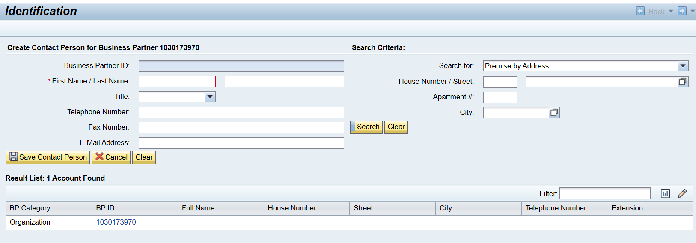
Create Contact Person
Current State Use: Users create contact persons in both CRM7 and ECC directly as a BUP001 Contact Person Role and associate the business partner to another business partner as a relationship. This contact person gets replicated to CRM7.
Future State Use: Users will be able to create a contact in Service Cloud v2. Decision needed to approve this direction? The same fields being utilized in CRM7 will be configured in Service Cloud v2.

Slide 15
Contract Account Number Ranges and Replication
A Contract Account (Also known as a Business Agreement) is the object via which financial postings are made. Financial documents posted to the contract account are subject to receivables management in the sub ledger in Contract Accounts Receivable and Payable (part of FI-CA). All charges and payments will be held at the contract account. It also has the control data for payment transactions and collections (i.e., dunning).
Contract Accounts will be created via SAP Service Cloud v2 as part of the Move In process and via SAP S4HANA. When creating a new contract account in S4HANA, SAP will use the internal number range configured for the contract account category in SAP S4HANA. Once the contract account is saved in S4HANA, the contract account will be 100000191906 as an example.
When creating a contract account from Service Cloud v2, SAP will use the external number range configured for the contract account category in S4HANA. Once the contract account is saved in S4HANA, the contract account will be 103001473067 as an example.
No | From No | To No | External | Category Description
C1 | 010000000000 | 010299999999 |  | Energy Contract Account
C2 | 020000000000 | 020299999999 |  | Collective Contract Account
C3 | 030000000000 | 030299999999 |  | Non-Energy Contract Account
C4 | 040000000000 | 040299999999 |  | Gas Trans Composite Account
C5 | 103000000000 | 109999999999 | X | Energy Contract Account
C6 | 203000000000 | 209999999999 | X | Collective Contract Account
C7 | 303000000000 | 309999999999 | X | Non-Energy Contract Account
C8 | 403000000000 | 409999999999 | X | Gas Trans Composite Account
C9 | 060000000000 | 060299999999 |  | Gas Trans Pooling Composite Account
CZ | 603000000000 | 609999999999 | X | Gas Trans Pooling Composite Account
SAP Service Cloud v2 will only create contract accounts with the Energy Contract Account Category.

Slide 16
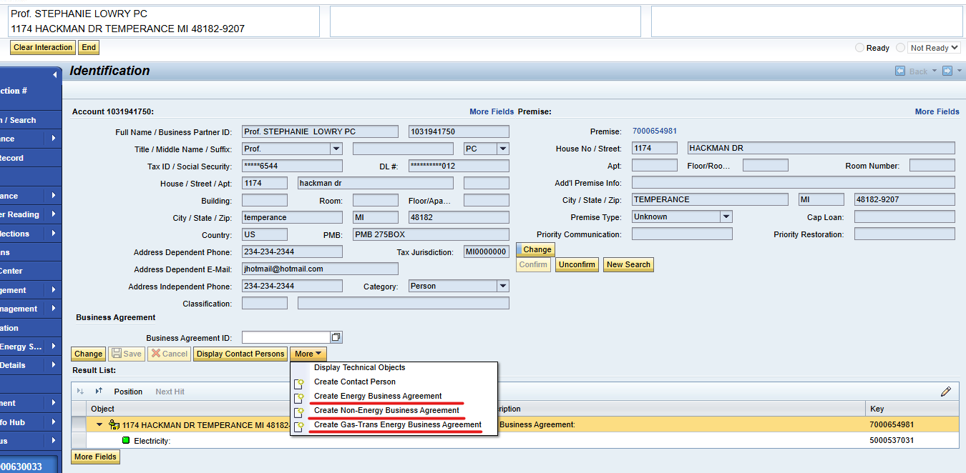
Create Contract Account in CRM
Current State Use: Some users create a new account to temporarily transfer funds if the customer does not have another account.
Future State Use: This functionality will be moved to Case Management PDD. Meaning agents will be trained to create a Case in Service Cloud v2 which will create a BPEM Case in S/4HANA.

Slide 17
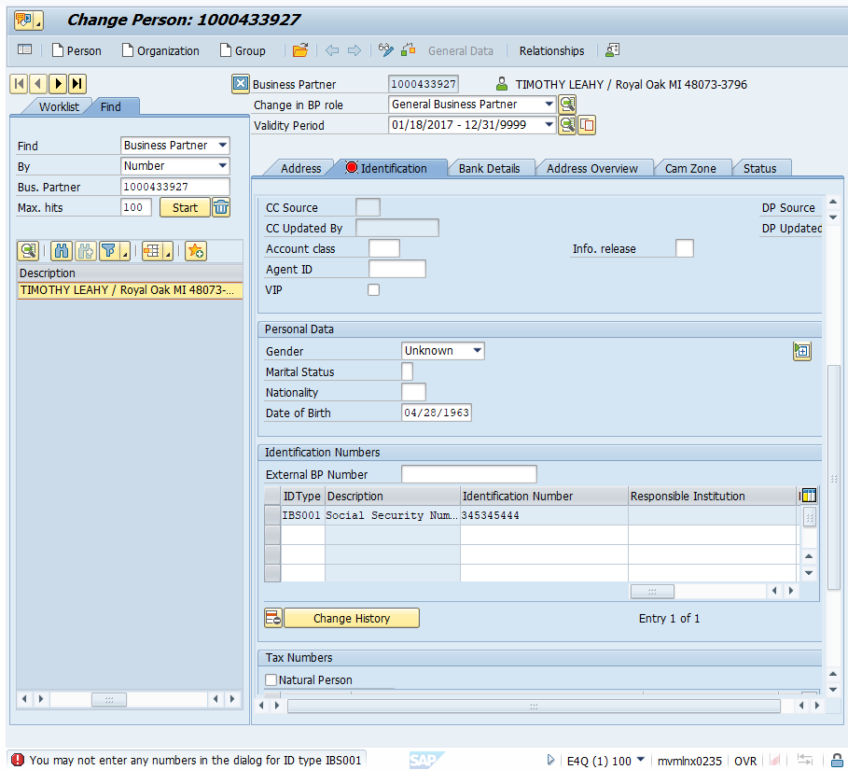
Identification Types
When creating a person business partner, the user will typically request a form of ID (i.e., Identification Type). Each of these identification types can be unique, meaning that the same identification number should not be assigned to different business partners. Identification Types will be created, changed, and viewed from SAP Service Cloud v2 as well as S4HANA.
Consumers has 96 Identification Types in CRM7 and 78 Identification Types in ECC. Service Cloud v2 will maintain mapping with the 78 Identification Types maintained in S4HANA.
FRICE-W "ID Type Field Masking" will cover any masking needs for the ID types being configured.

Slide 18
BP ID Types - 78
ZDUN$ | Dun & Bradstreet - Sales Amt
ZDUNCD | Dun & Bradstreet - Conf Code
ZDUNHQ | Dun & Bradstreet Number - HeadQuarter
ZDUNPT | Dun & Bradstreet Number - Parent
ZDUNST | Dun & Bradstreet Number - Standard
ZDUNUL | Dun & Bradstreet Number - Ultimate
ZEPLOC | Eservices Profile Locked
ZFCCOO | FCC Phone Opt-Out
ZFRAUD | Fraud
ZGASTR | Gas Transportation
ZGCCID | GCC Customer Block
ZHHCBP | HHC Annual File Bypass
ZIBS01 | SSN/Tax ID No.
ZIBS02 | Driver's license number
ZINC&I | Other C&I Customer
ZINEDU | Education Customer
ZINFNC | Franchise Customer
ZINGOV | Government Customer
ZINHEA | Healthcare Customer
ZINNAT | National Customer
ZINREL | Religious Customer
ZINUTL | Utility Industry Customer
ZLFSPT | Life Support
ZLOWIN | Low Income Customer
ZMEDCL | Medical Condition
ZMILID | Military ID
ZMINOR | Minor
ZMOFF | MMOP FORMAL SHUTOFF
ZNETME | Net Metering
ZNMRBD | Numerous Bad Debt
ZNOCHK | No Checks Accepted
ZNOCRD | No Payment Cards Accepted
ZPEND | Pending Theft/Fruad/TOV Investigation
ZPRTMR | Primetimers Club
ZPSSPT | Passport
ZPWD | Password
ZREFID | Refuses to Provide ID
ZSEGB | B
ZSEGB+ | B+
ZSEGP | P
ZSEGP+ | P+
ZSEGPL | PL
ZSELFH | High Income Range
ZSELFL | Low Income Range
ZSELFM | Medium Income Range
ZSOLAR | Solar Garden Customer
ZSTID | State ID - MI
ZSTIDO | State ID - Other
ZTAXEX | Tax Exemption Indicator
ZTDD | Hearing Impaired-TDD
ZTHEFT | Theft
ZTHRT | Threat of Violence
ZTHRTA | Aggressive Behavior
ZTHRTD | Threat of Violence - Dog
ZTHRTP | Threat of Violence - Police Escort
ZTRBID | Tribal ID
IDType | Description
BUP001 | Dun & Bradstreet Number
BUP002 | Commercial Register Number
BUP003 | Register of Associations Number
BUP004 | Public Register of Cooperatives Number
CRM002 | R/3 Customer Number
FS0001 | Identity card
IBS001 | Social Security Number
IBS002 | Driver's license number
ZAGENT | CEPASS CASE WORKER
ZAPNEA | Apnea Monitor
ZATN | DO NOT ENROLL ASP Termination Non-pay
ZATV | DO NOT ENROLL ASP Termination Voluntary
ZBCTR | Business Center 1-800-805-0490
ZCARE | CARE Program
ZCVM | Customer Value Management Score
ZCVMPS | CVM Price Score
ZCVMRS | CVM Switch Response Score
ZCVMSS | CVM Service Score
ZCVMVS | CVM Value Score
ZDCEAS | Deceased
ZDNB | Dun & Bradstreet Number
ZDPREQ | Deposit Requested 530-4170

Slide 19
BP Relationship Categories
Business Partner Relationships are used to model relationships between one business partner and another. Different relationship categories define the type of relationship between the business partners. Relationship categories will be different between person business partner categories and organization business partner categories. For example, person business partner could be spouses, parent/minor, or roommates. Whereas a person and an organization business partner could have a contact person relationship, such as an office manager or account manager. In addition to relationship category, time restrictions,(i.e., validity start and end dates) will also be captured when maintaining the relationship in the S4HANA system. A Business Partner can have multiple relationships of the same category (e.g., an organization could have five contact persons).
Consumers has 77 Business Partner Relationship Categories in CRM7and 45 Business Partner Relationship Categories in S4HANA. SAP offers standard business partner categories and configuration for business partner relationship categories. The following custom business partner relationship will be used at Consumers. Service Cloud v2 will be configured with the 45 Business Partner Relationship categories maintained in S4HANA. The existing relationship categories that are not mapped currently will be examined if there is any negative impact to data migration. The following custom business partner relationship will be used at Consumers.
Custom BP Relationships in S4HANA | Description | Custom BP Relationships in S4HANA | Description | Custom BP Relationships in S4HANA | Description
Z3PRTY | 3rd Party | ZGASCU | Gas Curtailment Contact | ZROA | ROA Contact
ZA/P | Accts. Payable Contact | ZGSTRS | Gas Trans Supplier | ZRSPTY | Second Responsible Party
ZABUS1 | Alt Business Contact1 | ZLLP01 | Landlord | ZSUBCH | Subsidiary/Child Co.
ZABUS2 | Alt Business Contact2 | ZOPISS | Operational Issues | ZSUBDV | Subsidiary/Corp Division
ZBNKRP | Bankruptcy Contact | ZOUTG1 | Alternate Outage Contact1 | ZTRUST | Trustee
ZCAM | CAM | ZOUTG2 | Alternate Outage Contact2 | ZVLOAD | Voluntary Load Reduction
ZCONT | MiscContactPerson(BusCtr) | ZOUTG3 | Alternate Outage Contact3 | ZPRCHD | Parent / Child Company
ZCOSGN | Co-Signor | ZPBUS | Primary Business Contact | ZPRDIV | Parent / Corp. Division
ZDIVCH | Corp Division / Child Co. | ZOUTGE | Primary Outage Contact | ZFRCHZ | Franchise
ZFIMGR | Financial Manager | ZPOFA | Power of Attorney | ZPRSUB | Parent / Subsidiary

Slide 20
BP Relationships Categories in S4HANA
Relationship Category | Description
BUR001 | Has Contact Person
BUR002 | Has Activity Partner
BUR003 | Has Shared Living Arrangement Member
BUR004 | Is Married To
BUR011 | Has the Employee Responsible
BUR013 | Is Replaced By
BUR025 | Is Inspector Of
BUR998 | Is Partner of
BURC01 | Is Shareholder Of
CHM001 | Responsible for Channel Partner
CRMS03 | Is the Responsible Scrapper For
EDO001 | Singapore: Has Peppol Endpoint ID
FS0030 | Borrower Entity Member
HEA010 | Has Hospital Employee
ZLLP01 | Has Community
ZOPISS | Has Operational Issues Contact
ZOUTG1 | Has Alternate Outage Contact 1
ZOUTG2 | Has Alternate Outage Contact 2
ZOUTG3 | Has Alternate Outage Contact 3
ZOUTGE | Has Primary Outage Contact
ZPBUS | Has Primary Business Contact
ZPOFA | Has Power of Attorney
ZPRCHD | Is Parent / Has Child Company
ZPRDIV | Is Parent / Has Corp. Division
ZPRSUB | Is Parent / Has Subsidiary
ZROA | Has ROA Contact
ZRSPTY | Has Secondary Responsible Party
ZSUBCH | Is Subsidiary / Has Child Co.
ZSUBDV | Is Subsidiary / Has Corp. Division
ZTRUST | Has Trustee
ZVLOAD | Has Voluntary Load Reduction Contact
FS0030 | Borrower Entity Member
HEA010 | Has Hospital Employee
HEA020 | Has Hospital Employee
Z3PRTY | Has 3rd Party
ZA/P | Has Accounts Payable Contact
ZABUS1 | Has Alternate Business Contact1
ZABUS2 | Has Alternate Business Contact2
ZBNKRP | Has Bankruptcy Contact
ZCAM | Has Corporate Account Manager
ZCONT | Has Misc Contact Person (BusCtr)
ZCOSGN | Has Co-Signor
ZDIVCH | Is Corp Division / Has Child Co.
ZFIMGR | Has Financial Manager
ZFRCHZ | Is Franchise of
ZGASCU | Has Gas Curtailment Contact
ZGSTRS | Is Gas Trans Supplier

Slide 21
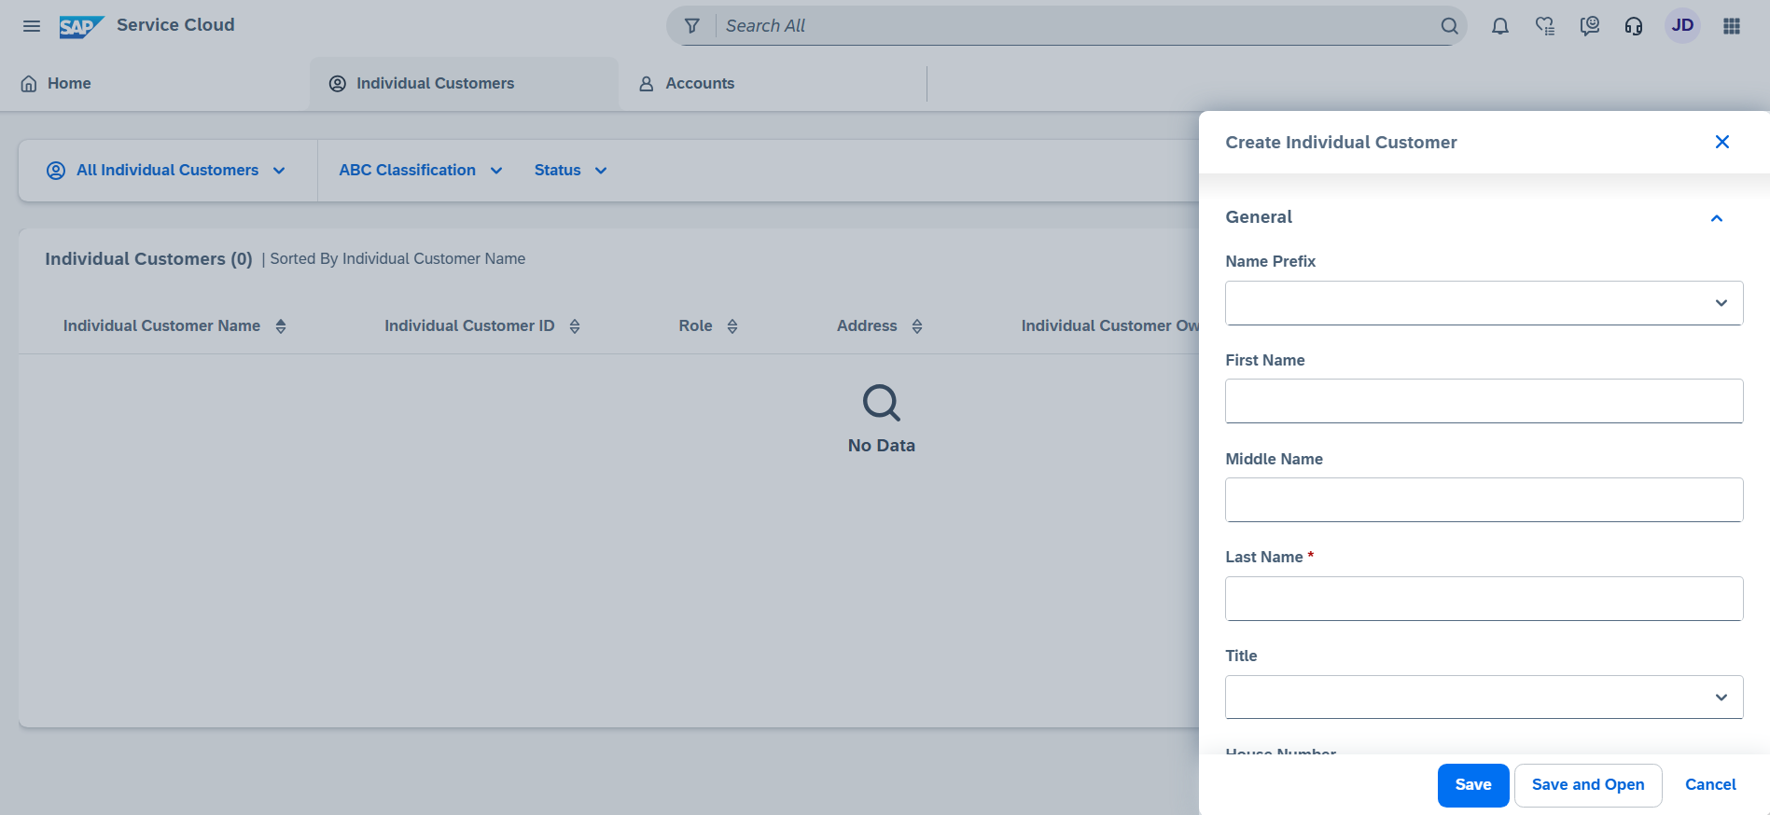
Create an Individual Customer in Service Cloud v2
An individual customer in SAP Service Cloud v2 is the equivalent of a person BP in CMR7. A user can create an Individual Customer through the Individual Customer work center.
FRICE-W "Business Partner Field Enhancements" will cover any custom fields that are needed.
Pain point to address: BPs are getting created with no phone number.

Slide 22
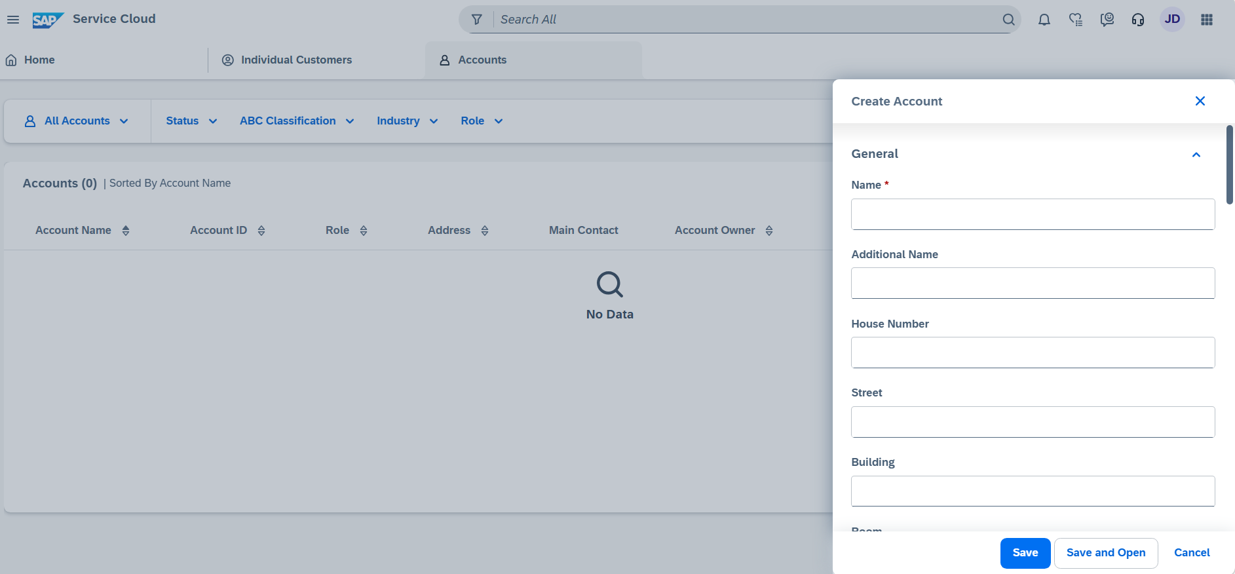
Create an Account in Service Cloud v2
An Account in SAP Service Cloud v2 is the equivalent of an Organization BP in CMR7. A user can create an Account through the Accounts work center.
FRICE-W "Business Partner Field Enhancements" will cover any custom fields that are needed.
Pain point to address: BPs are getting created with no phone number.

Slide 23
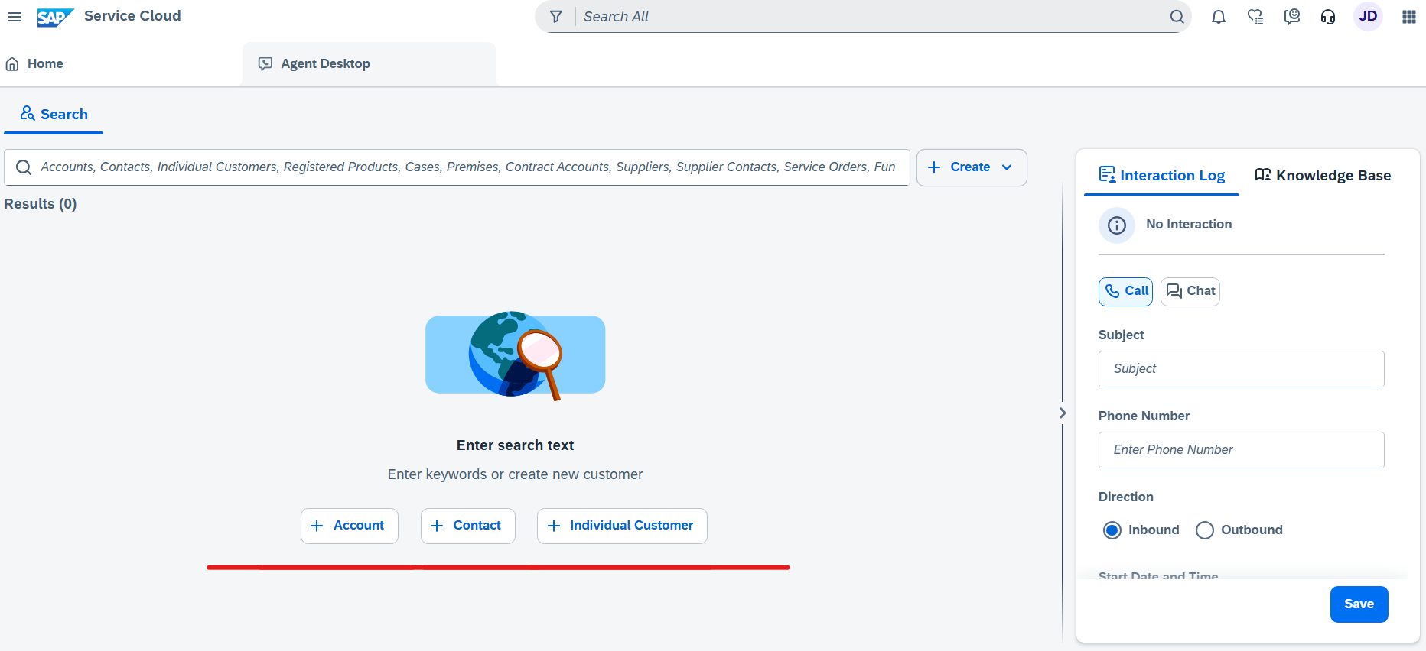
Create an Individual Customer, Contact, or Account in Service Cloud v2
A user will be able to create an Individual Customer, Contact, or Account in the Agent Desktop.

Slide 24
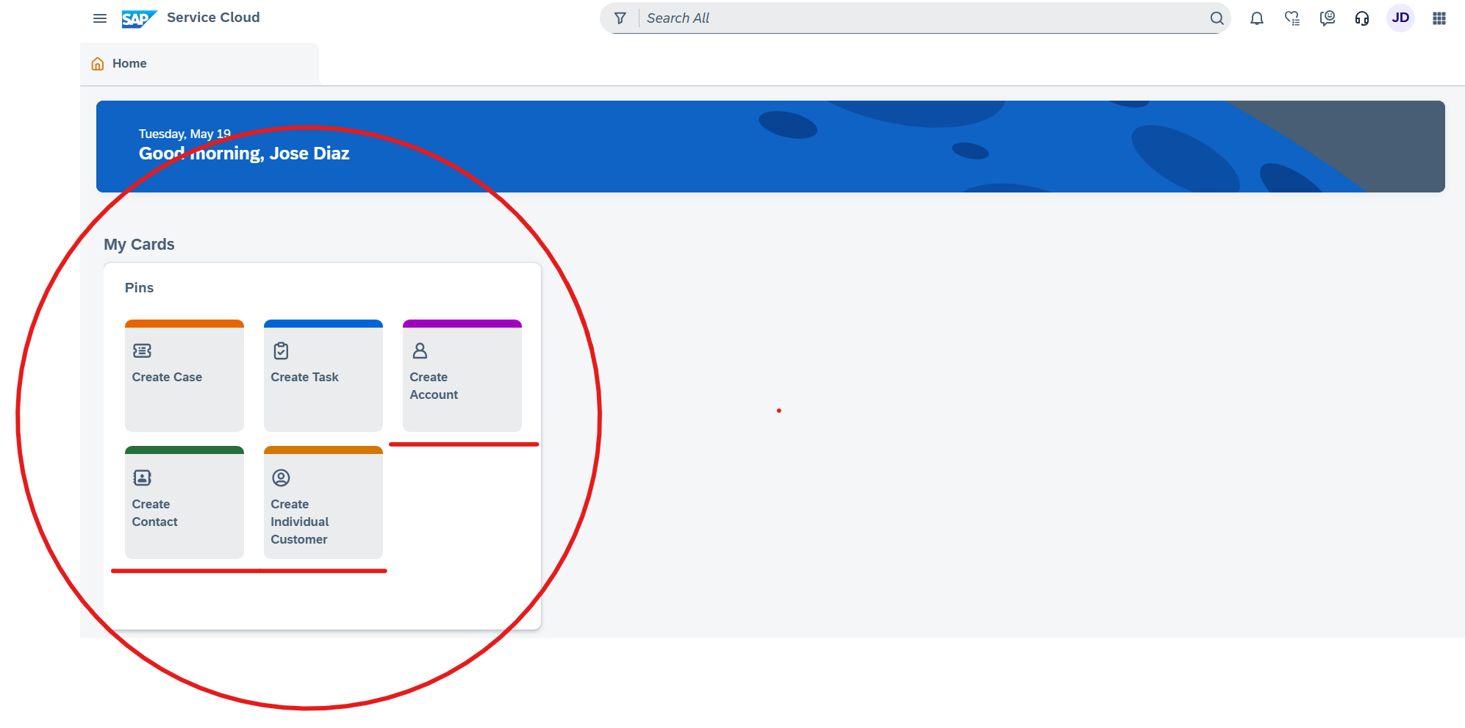
Create an Individual Customer, Contact, or Account in Service Cloud v2
A user will be able to create an Individual Customer, Contact, or Account through My Cards quick access on the Home Page.

Slide 25
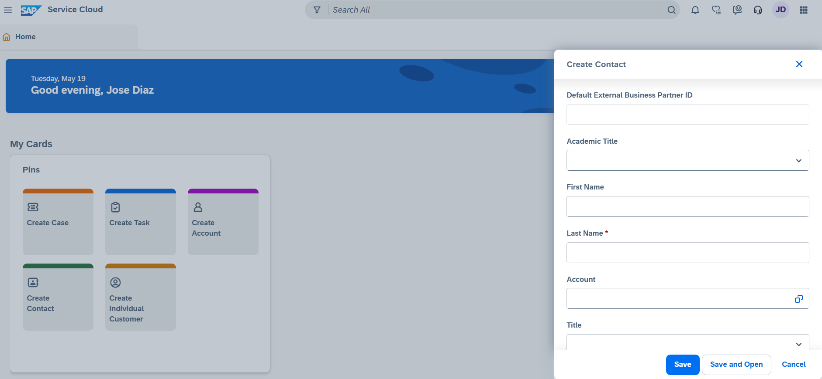
Create an Individual Contact in Service Cloud v2
A user will be able to create a Contact Person in Service Cloud v2.

Slide 26
BREAK! - 10 mins

Slide 27
03 (L3) Maintain Business Master Data

Slide 28
Maintain Person BP in CRM
Field | Mandatory | Optional | View Only | Field | Mandatory | Optional | View Only
Full Name |  |  | X | Info release |  | X
ID |  |  | X | BCC Dunning Hold |  | X
First Name | X |  |  | BCC Shut-Off Notice Suppression |  | X
Last Name | X |  |  | CC Status |  |  | X
Title |  | X |  | Date/Time |  |  | X
Middle Name |  | X |  | CC Updated By |  |  | X
Suffix |  | X |  | CC Source |  |  | X
Driver's License |  | X |  | DP Status |  |  | X
SSN |  | X |  | Date/Time |  |  | X
DL State |  | X |  | DP Updated By |  |  | X
DL Country |  | X |  | DP Source |  |  | X
Classification |  | X |  | People in Household |  | X
Employee Classification |  | X |  | Payment Frequency |  | X
Date of Birth |  | X |  | Household Income |  | X
Job Title |  | X |  | Updated Date |  |  | X
Do Not Solicit – VAPS |  | X |  | Source |  |  | X
No auto credit transfer |  | X

Slide 29
Maintain Org BP in CRM
Field | Editable | Optional | Defaulted | Field | Editable | Optional | Defaulted
Full Name |  |  | X | Floor |  | X
ID |  |  |  | City |  | X
Name1 | X | X | X | State | X
Name2 | X | X |  | Zip Code | X
Tax Identification |  | X | X | Country | X
Classification | X | X |  | PMB | X
CAM Zone | X | X |  | C/O | X
No auto credit transfer | X | X |  | Tax Jurisdiction Code | X | X
BCC Dunning Hold |  |  |  | Home Phone / Ext | X | X
BCC Shut-Off Notice Suppression |  |  |  | Mobile Phone / Ext | X | X
House |  |  |  | Address Independent E-Mail | X | X
Street |  |  |  | Website | X | X
Apt |  |  |  | VAPS Consent – Status
Building |  |  |  | VAPS Consent – Date / Time
Room |  |  |  | VAPS Consent – CC Updated By
Data Privacy - Status |  |  |  | VAPS Consent – CC Source
Data Privacy – Date/Time |  |  |  | Data Privacy – DP Updated By
Data Privacy – DP Source

Slide 30
Maintain Org BP in CRM
Field | Editable | Optional | Defaulted | Field | Editable | Optional | Defaulted
Full Name |  |  | X | Floor |  | X
ID |  |  |  | City |  | X
Name1 | X | X | X | State | X
Name2 | X | X |  | Zip Code | X
Tax Identification |  | X | X | Country | X
Classification | X | X |  | PMB | X
CAM Zone | X | X |  | C/O | X
No auto credit transfer | X | X |  | Tax Jurisdiction Code | X | X
BCC Dunning Hold |  |  |  | Home Phone / Ext | X | X
BCC Shut-Off Notice Suppression |  |  |  | Mobile Phone / Ext | X | X
House |  |  |  | Address Independent E-Mail | X | X
Street |  |  |  | Website | X | X
Apt |  |  |  | VAPS Consent – Status
Building |  |  |  | VAPS Consent – Date / Time
Room |  |  |  | VAPS Consent – CC Updated By
Data Privacy - Status |  |  |  | VAPS Consent – CC Source
Data Privacy – Date/Time |  |  |  | Data Privacy – DP Updated By
Data Privacy – DP Source

Slide 31
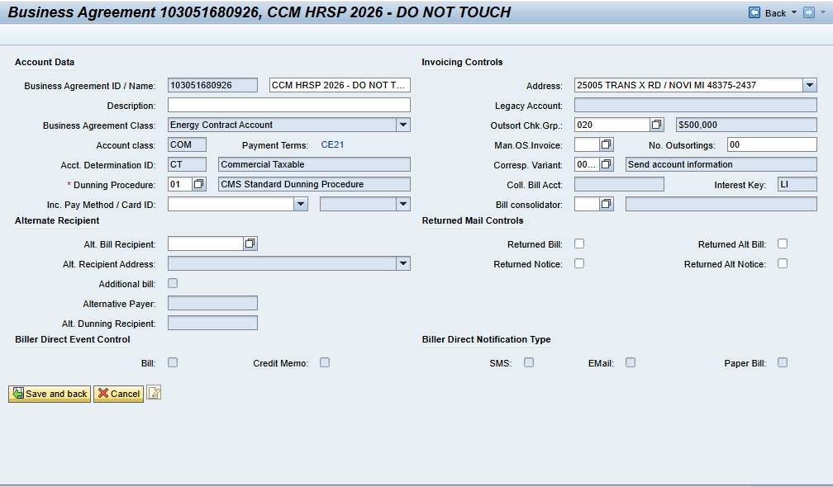
Maintain Business Agreement
Current State Use: Users can edit certain attributes associated to the Business Agreement.
Future State Use: Apart from editing a fixed address on the contract account, editing other contract account attributes will be moved to Case Management PDD. Meaning agents will be trained to create a Case in Service Cloud v2 which will create a BPEM Case in S/4HANA. Any other fields that need to be editable from Service Cloud v2 will be covered in the FRICE-W "Contract Account Field Enhancements."

Slide 32
Maintain Business Agreement in CRM
Field | Editable | Optional | Field | Editable | Optional
Business Agreement |  |  | No. Outsortings | X | X
Name | X | X | Correspondence Variant | X | X
Description | X | X | Coll. Bill Account
Business Agreement Class |  |  | Interest Key
Account Class |  |  | Bill Consolidator | X | X
Payment Terms | X | X | Returned Bill | X | X
Account Determination ID |  |  | Returned Notice | X | X
Dunning Procedure | X | X | Returned Alt. Bill | X | X
Incoming Payment Method | X | X | Returned Alt. Notice | X | X
Alternate Bill Recipient | X | X | Biller Direct Event Control
Alternate Recipient Address |  |  | Bill
Additional Bill |  |  | Credit Memo
Alternative Payer |  |  | Returned Mail Controls
Alternate Dunning Recipient |  |  | SMS
Address | X | X | EMail
Legacy Account |  |  | Paper Bill
Outsort Check Group | X | X
Manual OS Invoice | X | X
FRICE-W "Contract Account Field Enhancements" will cover any custom fields that are needed to be extended.

Slide 33
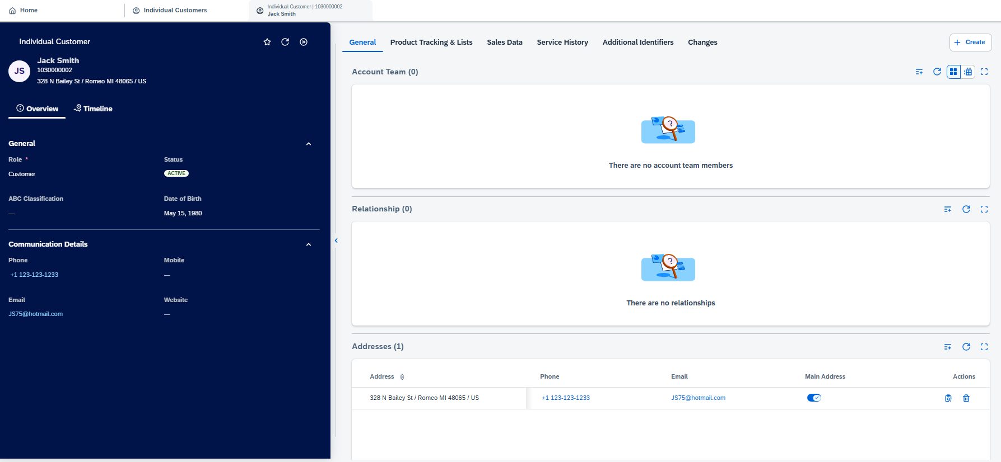
Maintain Individual Customer in Service Cloud v2
Users can maintain individual customer details like:
General Information
Communication Details
Account Team
Relationships
Id Types
Addresses
Notes
Attachments

Slide 34
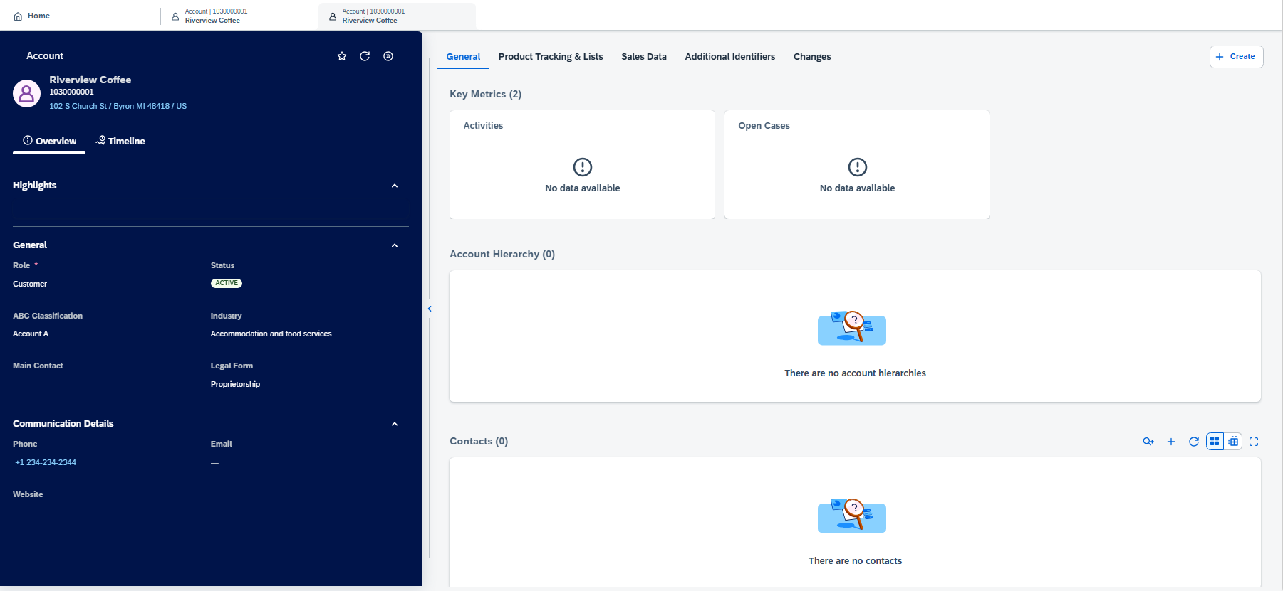
Maintain Account in Service Cloud v2
Users can maintain account details like:
General Information
Communication Details
Contact Persons
Account Team
Relationships
ID Types
Addresses
Notes
Attachments

Slide 35
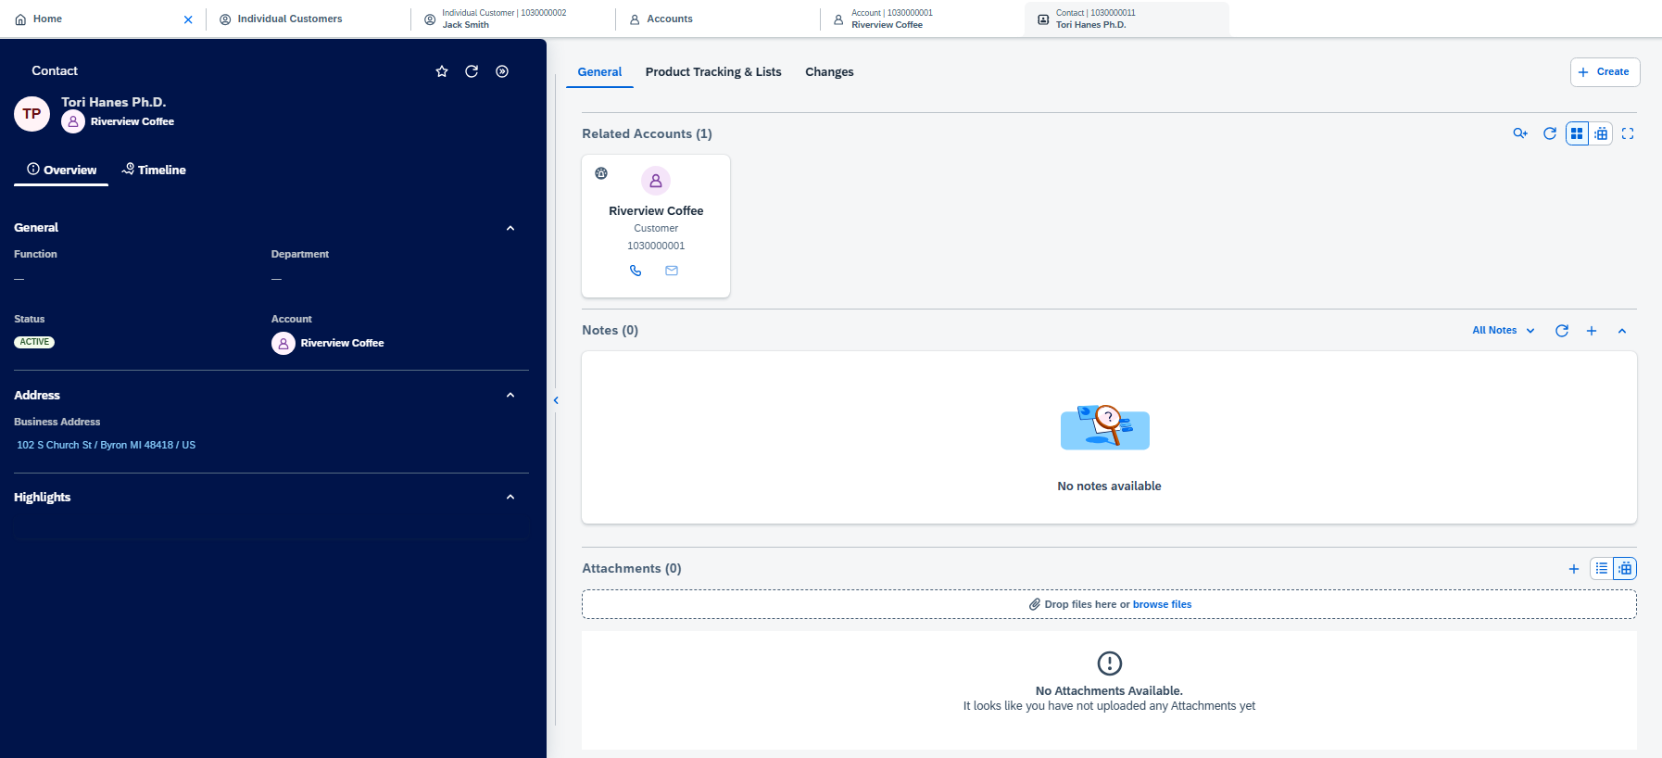
Maintain Contact in Service Cloud v2
Users can maintain account details like:
General Information
Communication Details
Notes
Attachments

Slide 36
04 Current & Future State Assumptions

Slide 37
Assumptions for Future State
Contact Accounts or Contracts will not be created in Service Cloud v2 individually. They will only be created during a move in process.
Service Cloud will not expose PO box address fields as DQM does not validate those fields.
Street 3 is used as the PMB (Private Mail Box) details. This field also does not get validated by DQM
PO Box details get added onto the Street field for DQM validation

Slide 38
05 (L3) Manage Financial Details

Slide 39
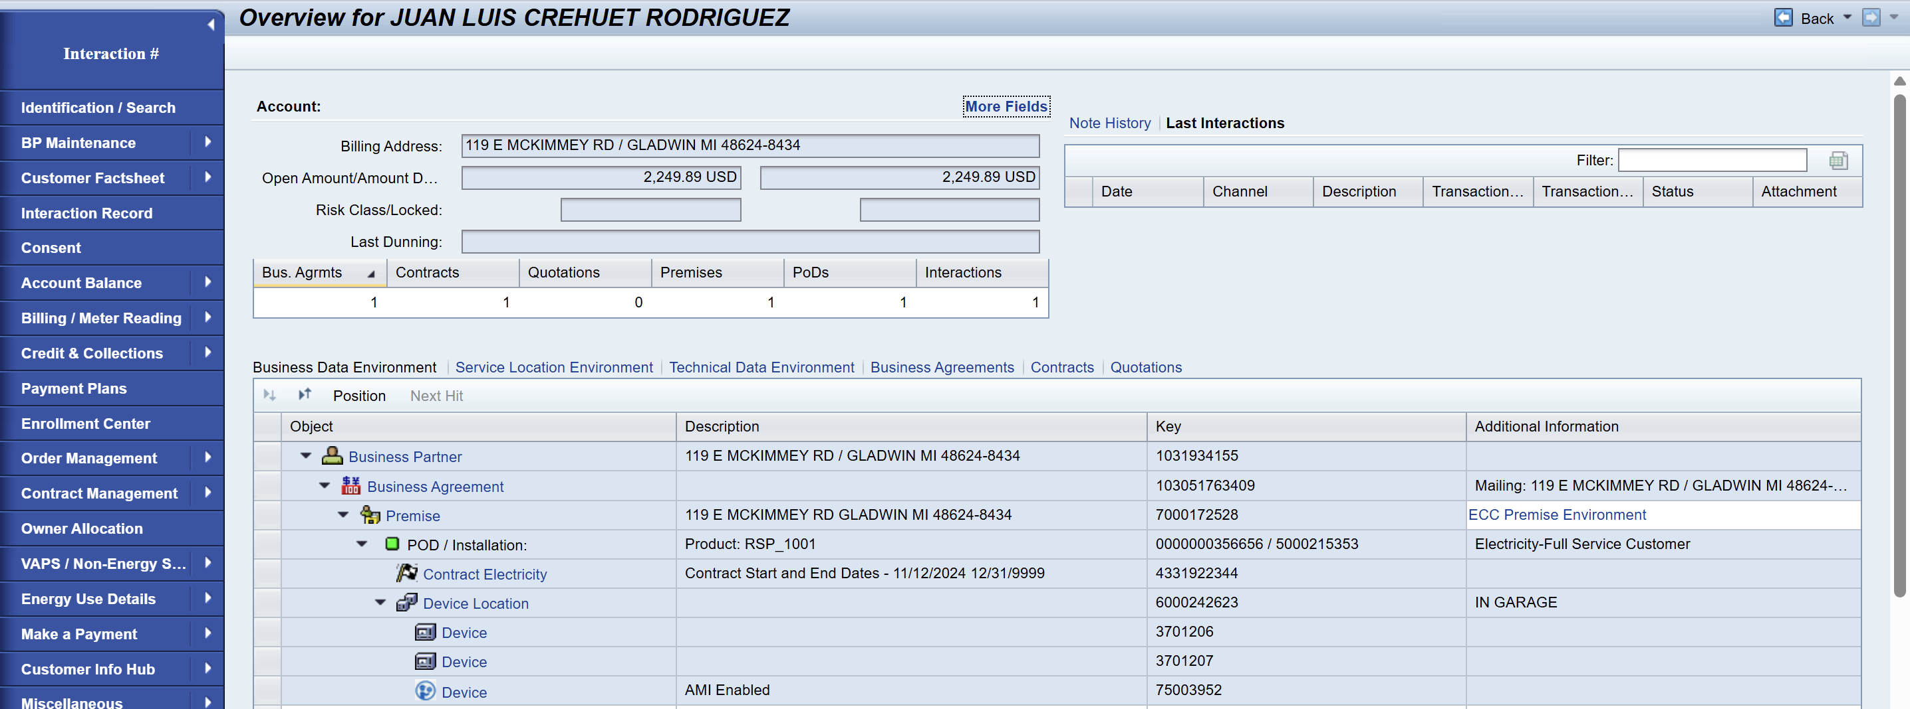
Data Environments

Slide 40
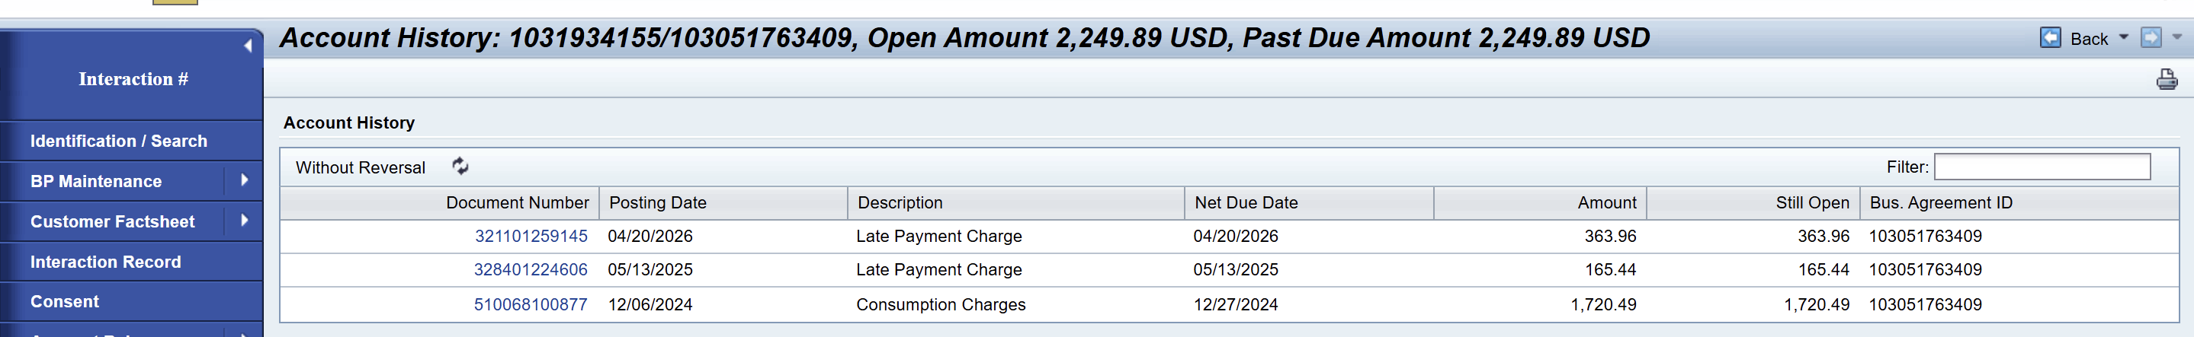
Account History
Currently in CRM7 - Accounts are merged (CE employees that are also CE Customers have an employee flag.
An external form is filled out outside of CRM (to ensure the Employee is keeping standard)
3,000 SD accounts need to be in Future State SCV2 (New Construction, Damage Claim) (Theft and Fraud Billed on Separate accounts) (3,000 Account)
Need to ensure that when all the data is migrated, the number ranges need to have the full range so they can match front to back

Slide 41
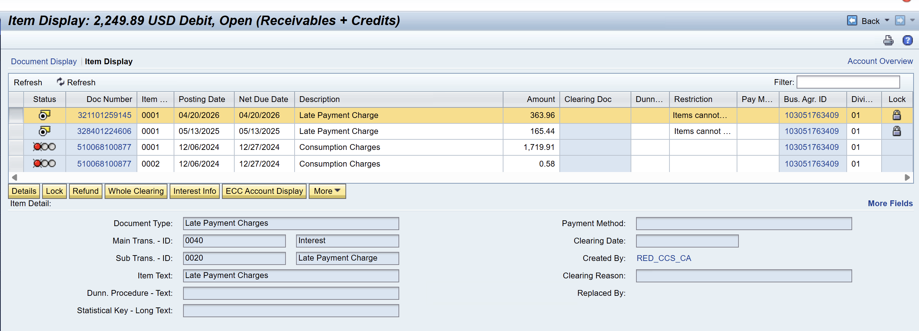
Open Item List

Slide 42
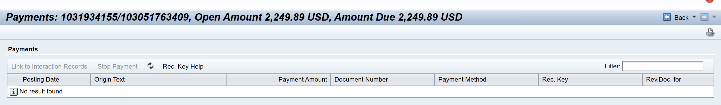
Payments List

Slide 43
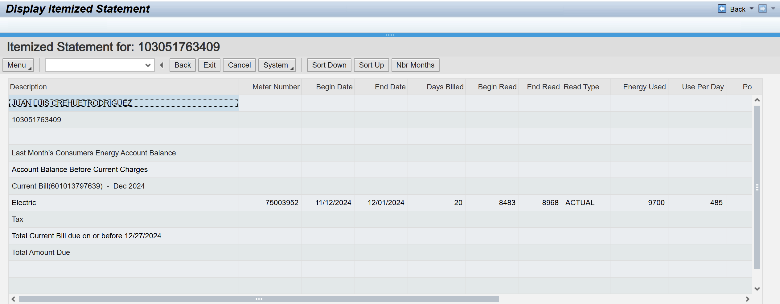
Display Itemized Statement

Slide 44
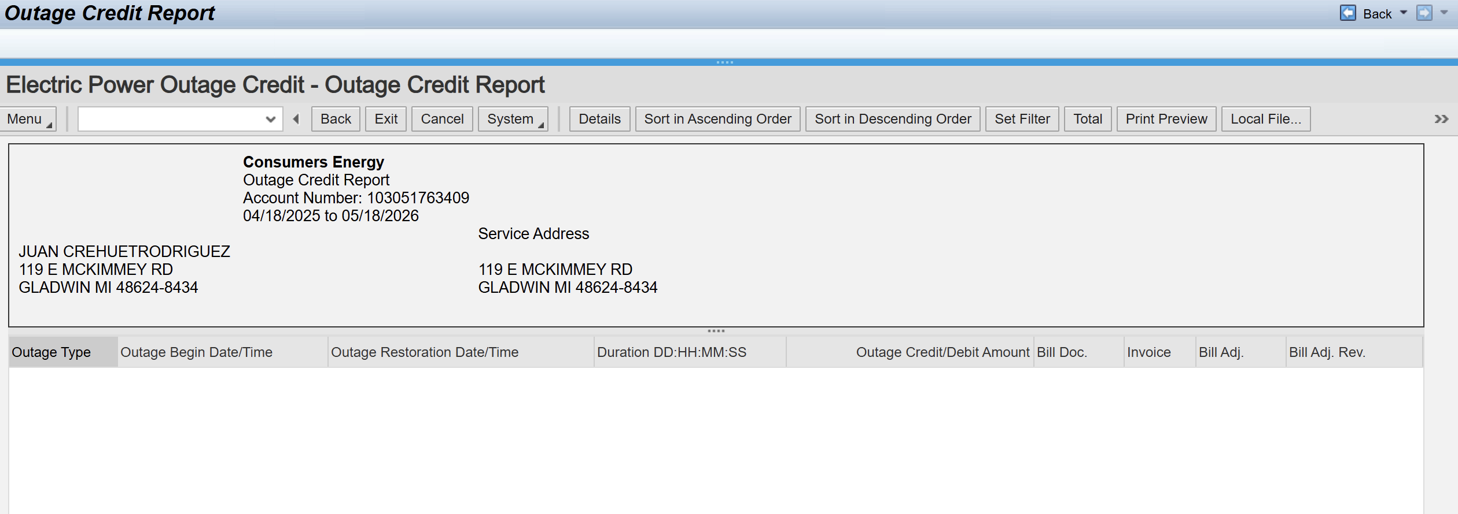
Outage Credit Report
Outage Credit Report launches to ECC​ in current state CRM7

Slide 45
05 Key Decisions

Slide 46
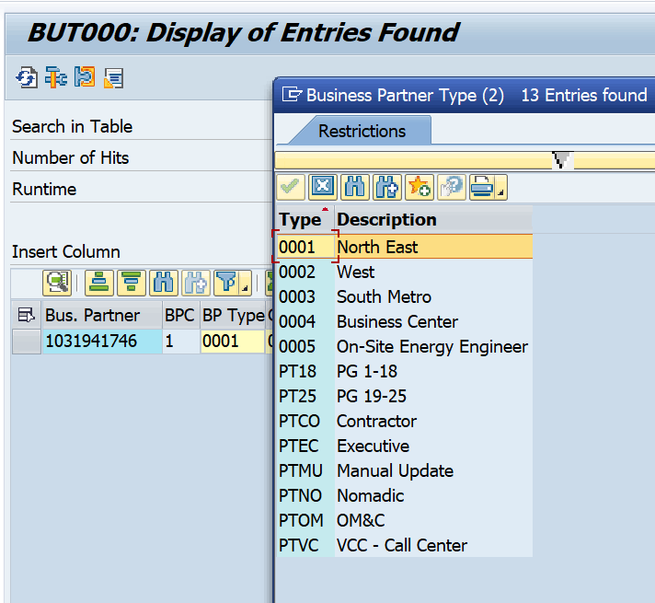
Key Open Question
Moving forward will Consumers continue to utilize Street 3 instead of PO Box fields?
How is the BP Type getting determined ? What is this value being used for?
Custom SSN and Driver's license field. What was the intention of this and not using standard ?

Slide 47
Potential Decisions captured in BMD Workshop A-1
Decision | Notes / Action Required
Titles should not auto populate gender in V2 | In Service Cloud V2, gender should not be defaulted based on other fields. There have been many issues in current state with customers not being identified with the correct title.
Will PO Box Fields be needed for future state? | Need to check if there are PO Boxes that are utilizing fields in CRM7, need to determine if we need this for future state. (DQM is not validating these fields) Confirmed: Private PO Box Field is currently being used so will need that for the future state
Will we need to show VAPS DNS or Info Release in SC V2 for Org BPs? | Business Center wants the DNS flags (INFO RELEASE) - they do not need the Do Not Solicit-VAPS they will use INFO RELEASE in BP so they can add this flag vs. having to send it to Digital Ops to add.
Coding for Notes Interaction in Service Cloud V2 | Currently in CRM7 the Notes Interaction is coded through ECC. Need to decide how we will be doing this for Service Cloud.

Slide 48
06 FRICE-W

Slide 49
FRICE-W Identified
Telephone number format and length validation
ID Masking
ID types format and length validation
Driver's License format and length
Social Security format and length
DQM address validation
Business Partner Field Enhancements (Custom fields and extension)
Contract Account Field Enhancements (Custom fields and extension)

Slide 50
07 Drafted User Stories

Slide 51
User Stories for Create and Maintain Business Master Data
User story generator
Please note, this is just a drafted starting point we will leverage to formulate our actual user stories and acceptance criteria
L1 | L2 | L3 | L4 | User Story | Acceptance Criteria
Manage Customer Service | Create & Maintain Business Master Data (BMD) | Create Business Master Data | Create and Maintain Business Partner | As an SAP Customer Service Master Data Specialist, I want to Create Business Master Data by creating and maintaining business partners within the Create & Maintain Business Master Data area of Manage Customer Service to ensure reliable and current operational records. | Able to enter business partner data for creation. 3.Able to save a newly created business partner record. 4.Able to open an existing business partner for maintenance. 5.Able to edit business partner data during maintenance. 6.Able to save maintained changes to a business partner record. 7.Able to view a business partner record after creation or maintenance. 8.Able to select a business partner record for maintenance from available records. 9.Able to build Security roles and perform testing. 10.Able to identify Risk and Controls 11. Able to add both Dependent and Independent telephone, mobile and landline
11 | Create & Maintain Business Master Data (BMD) | Modify Business Master Data | Display Business Partner | As an SAP Business Partner Specialist, I want to modify Business Master Data within Manage Customer Service so that I can maintain accurate and up-to-date business partner records across related processes. | Able to search a business partner by Business Partner ID. 3.Able to search a business partner by name. 4.Able to view displayed business partner general information. 5.Able to view displayed business partner address information. 6.Able to view displayed business partner contact information. 7.Able to view displayed business partner role assignments. 8.Able to navigate back from the display without saving changes. 9.Able to build Security roles and perform testing. 10.Able to identify Risk and Controls 11. Able to edit both Dependent and Independent telephone, mobile and landline
Manage Customer Service | Create & Maintain Business Master Data (BMD) | Manage Financial Details | Manage Financial Details | As an SAP Master Data Specialist, I want to manage financial details within customer service business master data to maintain accurate, consistent information supporting service operations and decision making. | 1. Able to view financial details for a business master record. 3.Able to update financial details for a business master record. 4.Able to delete financial details for a business master record. 5.Able to save financial details changes. 6.Able to cancel unsaved financial details changes. 7.Able to verify completeness of financial details before saving. 8.Able to retrieve financial details using the business master identifier. 9.Able to build Security roles and perform testing. 10.Able to identify Risk and Controls
Manage Customer Service | Create & Maintain Business Master Data (BMD) | Manage Financial Details | Manage Financial Details | As an SAP Customer Service Master Data Specialist, I want to manage financial details within business master data so that accurate and consistent financial information supports customer service operations and reporting across the application. | 1. Able to edit existing financial details. 3.Able to view financial details for a selected record. 4.Able to validate required financial fields before save. 5.Able to save financial details successfully. 6.Able to delete financial details. 7.Able to search financial details by master data identifier. 8.Able to list all financial details for a business master. 9.Able to cancel unsaved changes to financial details. 10.Able to build Security roles and perform testing. 11.Able to identify Risk and Controls

Slide 52
08 3rd Party Integration

Slide 53
Direct and Indirect Integrations with CRM & ECC
Direct Integrations With CRM 7
3rd Party Integrations with ECC
(Not an exhaustive List)
CRM 7
Power App
Equifax
Riverstar
DQM
Honeywell
ISIS
Paymentus
FiServ
Kubra
MS (COMET)
BillTrust
Energy Use Dashboard
Legend
Cust Svc
Billing
Programs
Payment and Collections
Digital
CleanPower
Customer Portal Admin (CE)
Mobile Phone Application (Apollo) (CE)
DRMS
Lorton
JP Morgan
5th and Third
Harris and Harris
GridX (Was Uplight)
Sagewell
Powerely
OnCourse Home Solutions (OHS)
ESG
GCI
My Meter is gone
Paymentus
Helvey
State of Michigan
DegreeDays.Net
Itron (In Review)
MISO
THAW
DHHS
DebtNext
Notes:
Discussions around keeping integrations as direct vs the BTP connection
Tarah’s notes – Paymentus dashboard does get information from CRM but it does not pass anything else back – any other information would get passed to ECC only. State of Michigan has no interactions that I am aware of with CRM. There is interaction with Assistance Portal and these payments do impact TN SNP automatic workflow but all this is ECC that I am aware of.

Slide 54
09 Data Migration

Slide 55
Potential Tables
CRMD_ACTIVITY_H
CRMD_ORDERADM_H
CRMD_ORDERADM_I
CRMV_LINKPARTNER

Slide 56
10 Key Decisions, Action Items, Change Impacts, Wrap-Up & Next Steps

Slide 57
Program Charging (CE Internal Only)
The Change & Why:
We need to track O&M costs more precisely. OCM and Data Conversion must be charged separately from End User Training and from Design/Build/Deployment work. This change is retroactive from February for Accounting, Rate case discovery, and audit.
Ask:
Pls follow the instructions below that apply to you based on your staffing category on the LaunchPad program. It is critical to track costs in the correct cost buckets.
Business Partner (BP) Core Team (Use SAP*):
Continue 100% allocation as before. (BP&A handles this automatically behind the scenes and no time entry is needed except for the two scenarios below)
Submit time only for OCM and Data Conversion activities; Use SAP to bill IO 6520973.
Submit time only for End User Training; Use SAP to bill IO 6519532.
IT Core Team (Use Clarity):
S4- Customer – Design/Development/Testing/Deploy Clarity Task
Clarity Timesheets will now be used for time charging, and the allocation mechanism is discontinued. Submit timesheets from February 2nd for a one-time catchup.
Separate tasks for OCM, End User Training, and Data Conversion are available; Find them using keywords OCM, End User Training, and Data Conversion and charge them as applicable.
Extended BP Team (use SAP*):
Bill SAP IO 6520973 for OCM and Data Conversion.
Bill SAP IO 6519532 for End User Training.
Use new IO 6521411 for all other tasks.
Extended IT Team (Use Clarity):
S4- Customer – Design/Development/Testing/Deploy Clarity Task
Bill specific tasks for OCM, End User Training, and Data Conversion; ID the tasks using the keywords OCM, End User Training, and Data Conversion.
Bill other tasks as appropriate.
*SAP Timesheet Submission Instructions (for BPs)
Follow ESS steps (screen shot below): 1. Open ESS timesheet. 2. Enter IO number in work order field. 3. Select WORK code under ATT-ABS. 4. Add OCM, End User Training, or Data Conversion in comments. 5. Enter hours worked.

Slide 58
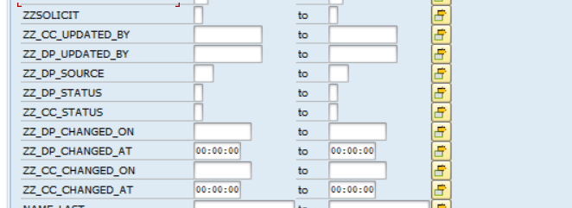

Slide 59




WORKSHOP OBJECTIVES AND OUTCOMES
OBJECTIVES
Confirm As-Is Process maps to future state
Define BMD Process Procedures
Identify key data, reporting and cross-functional requirements
OUTCOMES / INPUTS TO DELIVERABLES
Updated User Story / Task in Azure DevOps
Documented Change Impacts
Identified gaps / WRICEFs
Understand Remediation Scope
GROUND RULES
In Person
Virtual
Start and End the workshop on time
Please keep side conversations to a minimum
Questions are encouraged
Try not to use acronyms (when possible)
Unmute yourself to speak, and then mute immediately after
All questions to be posted in the meeting chat
Ensure that everyone has their cameras on when possible
Please allow time for breaks
Cell phones, laptops, and tablets switched off
Please ensure your understanding
Resist the temptation to multitask
If background noise hand off to a colleague and mute to reestablish your environment
Use the “raise hand” feature to ask questions
For troubleshooting, individually contact the host (Scrum Master)

Slide 60
Objective
Offer a holistic view of all the key elements of the to-be process including organization/roles, configuration or customization if needed, data, reporting, security, and controls requirements. Define the target-state ownership and L3 processes. Document key assumptions/decisions and outline any FRICE-W's and reports.
Ownership
L3 Processes
Assumptions / Decisions
FRICE-W / Reports

Slide 61
Maintain Person BP in CRM
Field | Mandatory | Optional | Defaulted | Field | Mandatory | Optional | Defaulted
First Name | X |  |  | Apartment |  | X
Last Name | X |  |  | Building |  | X
Middle Name |  | X |  | Room |  | X
Title |  | X |  | Floor |  | X
Suffix |  | X |  | City | X
Drivers License # |  | X |  | State | X
Drivers License State |  | X |  | Zip Code | X
Drivers License Country |  | X |  | Country | X |  | X
Social Security # |  | X |  | PMB |  | X
Tax Jurisdiction | X |  | X | Address Dependent Landline # |  | X
House |  | X |  | Address Dependent Mobile # |  | X
Street | X |  |  | Address Dependent Email |  | X

